Slide 1






CONTOSO
Organization chart
Mirjam
Nilsson
President
August Bergqvist
VP Finance
Allan Mattsson
VP Technology
Flora Berggren
VP Operations
Mira Karlsson
VP Marketing
Kalle Persson
VP Product
Alexander Persson
VP Human Resources
Alexander Martensson
Accounting Manager
Angelica Astrom
Engineering Director
Ian Hansson
Facilities Manager
April Hansson
Marketing Manager
Jens Martensson
Product Manager
Angelica Hansson
HR Manager
Jens Martensson
Accounting Manager
Angelica Hansson
Engineering Director
Alexander Martensson
Product Manager
Ian Hansson
Engineering Director
Ian Hansson
Product Manager
Jens Martensson
Engineering Director

Slide 2



CONTOSO
Organization chart
Domestic
National
International
Mirjam Nilsson
President
August Bergqvist
VP Finance
Allan Mattsson
VP Technology
Flora Berggren
VP Operations
Mira Karlsson
VP Marketing
Alexander Martensson
VP Product
Ian Hansson
VP Human Resources
Alexander Martensson
Accounting Manager
Angelica Astrom
Engineering Director
Ian Hansson
Facilities Manager
April Hansson
Marketing Manager
Jens Martensson
Product Manager
Angelica Hansson
HR Manager
Jens Martensson
Accounting Manager
Ian Hansson
Engineering Director
Alexander Martensson
Product Manager
Ian Hansson
Engineering Director
Ian Hansson
Product Manager

Slide 3








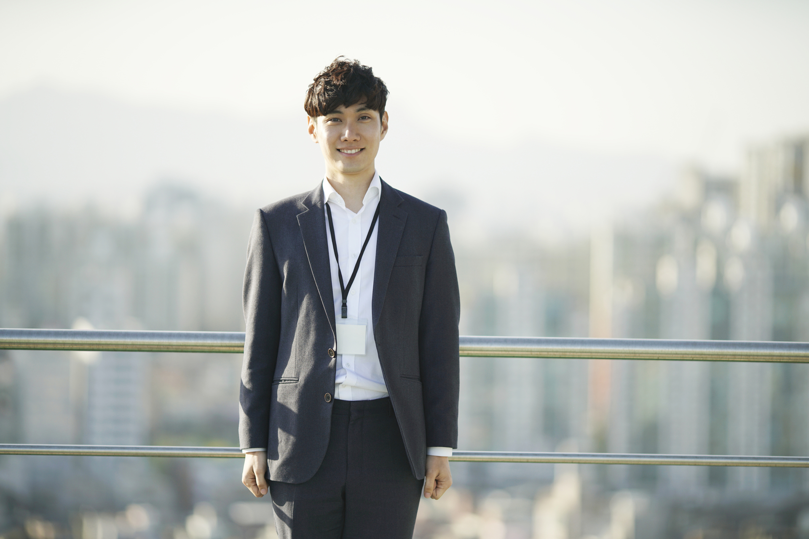


CONTOSO
Organization chart
Mirjam Nilsson
President
Domestic
National
International
Victoria Lindqvest
Executive Assistant
August Bergqvist
VP Finance
Alan Mattson
VP Technology
Flora Berggren
VP Operations
Mira Karlsson
VP Marketing
Kalle Persson
VP Product
Victoria Hansson
VP Human Resources
Alexander Martensson
Accounting Manager
Angelica Astrom
Engineering Director
Ian Hansson
Facilities Manager
April Hansson
Marketing Manager
Jens Martensson
Product Manager
Angelica Hansson
HR Manager
Jens Martensson
Accounting Manager
Ian Hansson
Engineering Director
Alexander Martensson
Product Manager
April Hansson
Engineering Director
Ian Hansson
Product Manager

